Slide 1
Practice 1 Combinational and Sequential Circuits
Oleg Ladin
7 October 2019

Slide 2
SR Latch
Scheme
Symbol
Truth table
reset
S | R | Qt-1 | Qt
0 | 0 | Q | Q
0 | 1 | Q | 0
1 | 0 | Q | 1
1 | 1 | Q | 0
Q
R
Q
S
!Q
!Q
set
Prohibited state

Slide 3
D Latch
Scheme
Symbol
Truth table
Data
D | we | Qt-1 | Qt
D | 0 | Q | Q
0 | 1 | Q | 0
1 | 1 | Q | 1
S
!Q
D
Q
R
Q
we
Write enable

Slide 4
Task 1: Binary Decoder
A binary decoder is a logic circuit that converts a binary integer value to an associated pattern of output bits.
A₀ | A₁ | D₀ | D₁ | D₂ | D₃
0 | 0 | 1 | 0 | 0 | 0
0 | 1 | 0 | 1 | 0 | 0
1 | 0 | 0 | 0 | 1 | 0
1 | 1 | 0 | 0 | 0 | 1

Slide 5
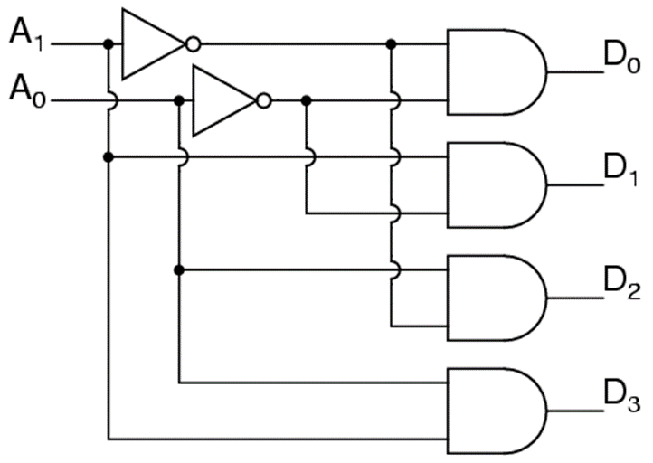
Task 1: Binary Decoder – Answer
A binary decoder is a logic circuit that converts a binary integer value to an associated pattern of output bits.
A₀ | A₁ | D₀ | D₁ | D₂ | D₃
0 | 0 | 1 | 0 | 0 | 0
0 | 1 | 0 | 1 | 0 | 0
1 | 0 | 0 | 0 | 1 | 0
1 | 1 | 0 | 0 | 0 | 1

Slide 6
Task 2: Multiplexer
A multiplexer (or mux) is a device that selects one signal and forwards the selected input into a single line.
The entry wires are address bus and data buses
Address bus is connected via decoder
M₀
M₁
A₀ | A₁ | Out
0 | 0 | M₀
0 | 1 | M₁
1 | 0 | M₂
1 | 1 | M₃
Out
M₂
M₃
A₀
A₁

Slide 7
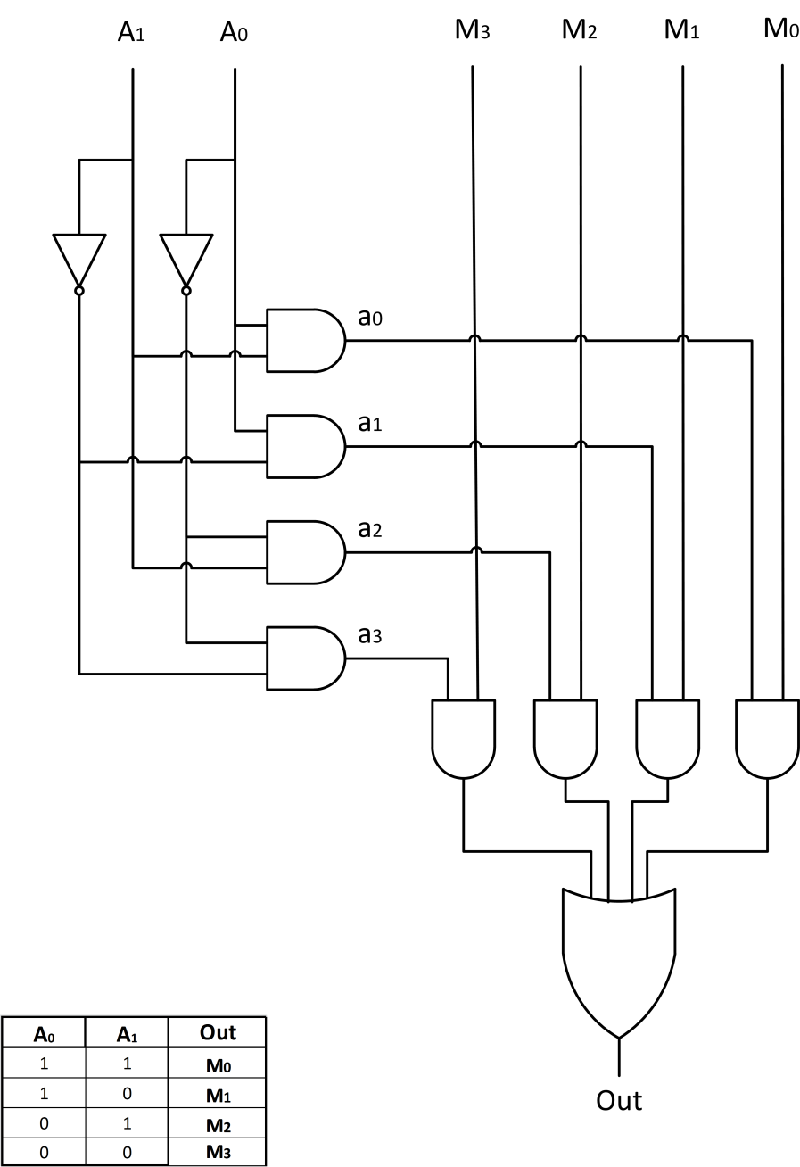
Task 2: Multiplexer – Answer
A multiplexer (or mux) is a device that selects one signal and forwards the selected input into a single line.
The entry wires are address bus and data buses
Address bus is connected via decoder
M₀
M₁
A₀ | A₁ | Out
0 | 0 | M₀
0 | 1 | M₁
1 | 0 | M₂
1 | 1 | M₃
Out
M₂
M₃
A₀
A₁

Slide 8
Single port 2^{M}xN Memory Array
Memory array has 3 input signals and 1 output
Data buses are N bits wide (each chunk is N bits)
Address is M bits wide if 2^{M} is array size
address
M
Write enable
Memory
Array
N
N
input data
output data

Slide 9
Task 3: Single port 4x1 Memory Array
Data is stored in D latches
Use decoder and mux to select memory entry
address
2
Write enable
Memory
Array
1
1
input data
output data

Slide 10
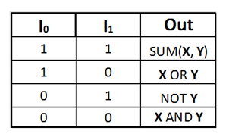
Arithmetic Logic Unit
ALU is a circuit that is able to perform different arithmetic and bitwise logical operations on integer binary numbers
ALU
Operand 1 (X)
Result (out)
Operand 2 (Y)
Opcode (I)

Slide 11
Comparator
A comparator is a device that takes two numbers as input in binary form and determines whether one number is greater than, less than or equal to the other number
 | EQ | LEQ
A>B | 0 | 0
A==B | 1 | 1
A<B | 0 | 1
 | LE | EQ | GR
A>B | 0 | 0 | 1
A==B | 0 | 1 | 0
A<B | 1 | 0 | 0

Slide 12
Edge-triggered D Latch (D flip-flop)
D | we | Qt-1 | Qt
D
Q
D
0
Q
Q
D
1
Q
Q
clk (we)
D
↑
Q
D
D
↓
Q
Q
Don’t open for writing neither at we =0 nor at we =1
It is open for a very small amount of time when the write enable goes from 0 to 1
It is a trigger asserted by the positive edge of write enable signal
Such types of triggers are mostly used to organize pipelined execution

Slide 13
Home work
Create scheme in Logisim – several variants
Will be announced via email

Slide 14
Thank You

